Slide 1
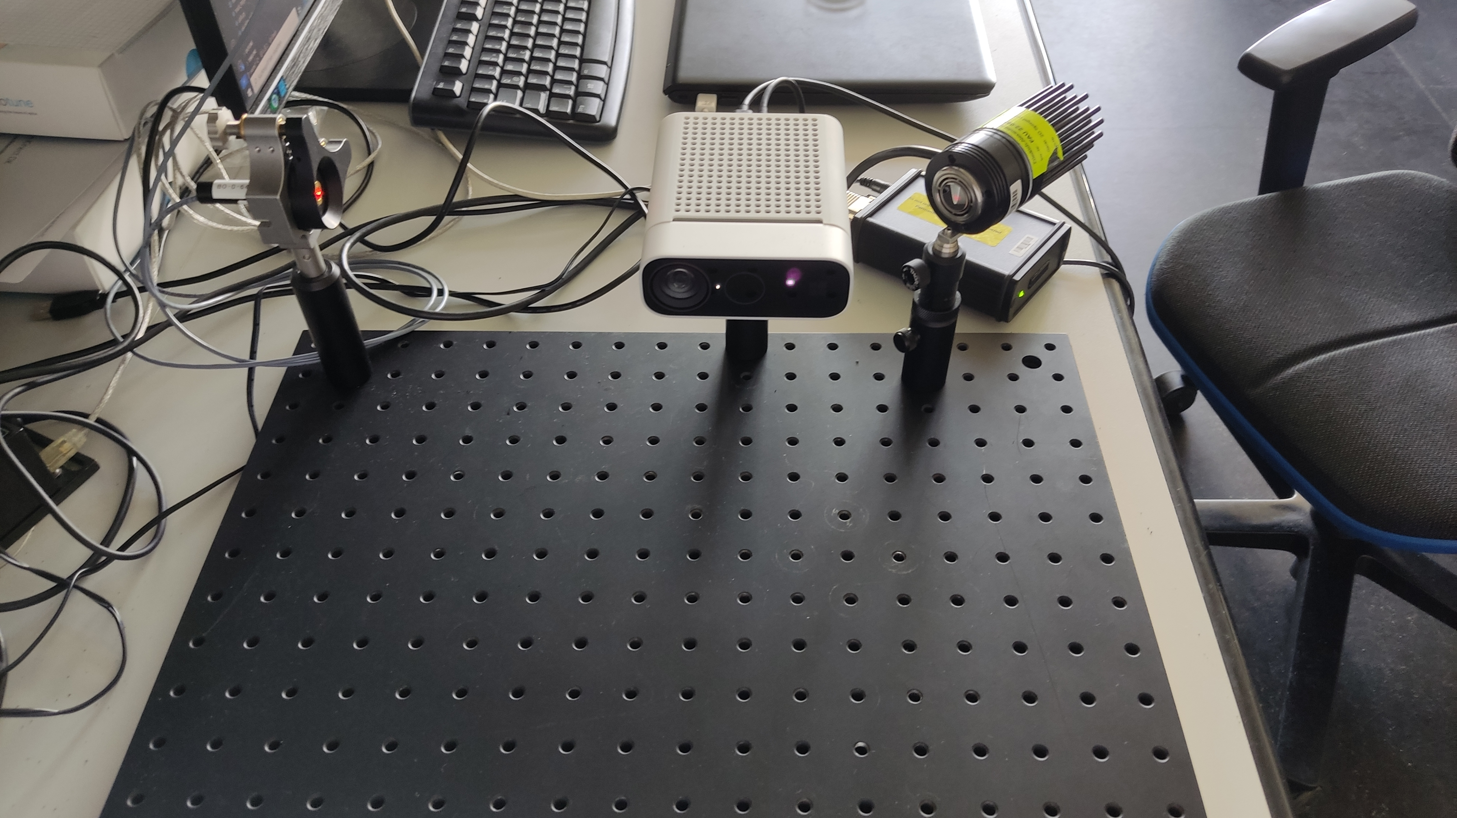
System Setup

Slide 2
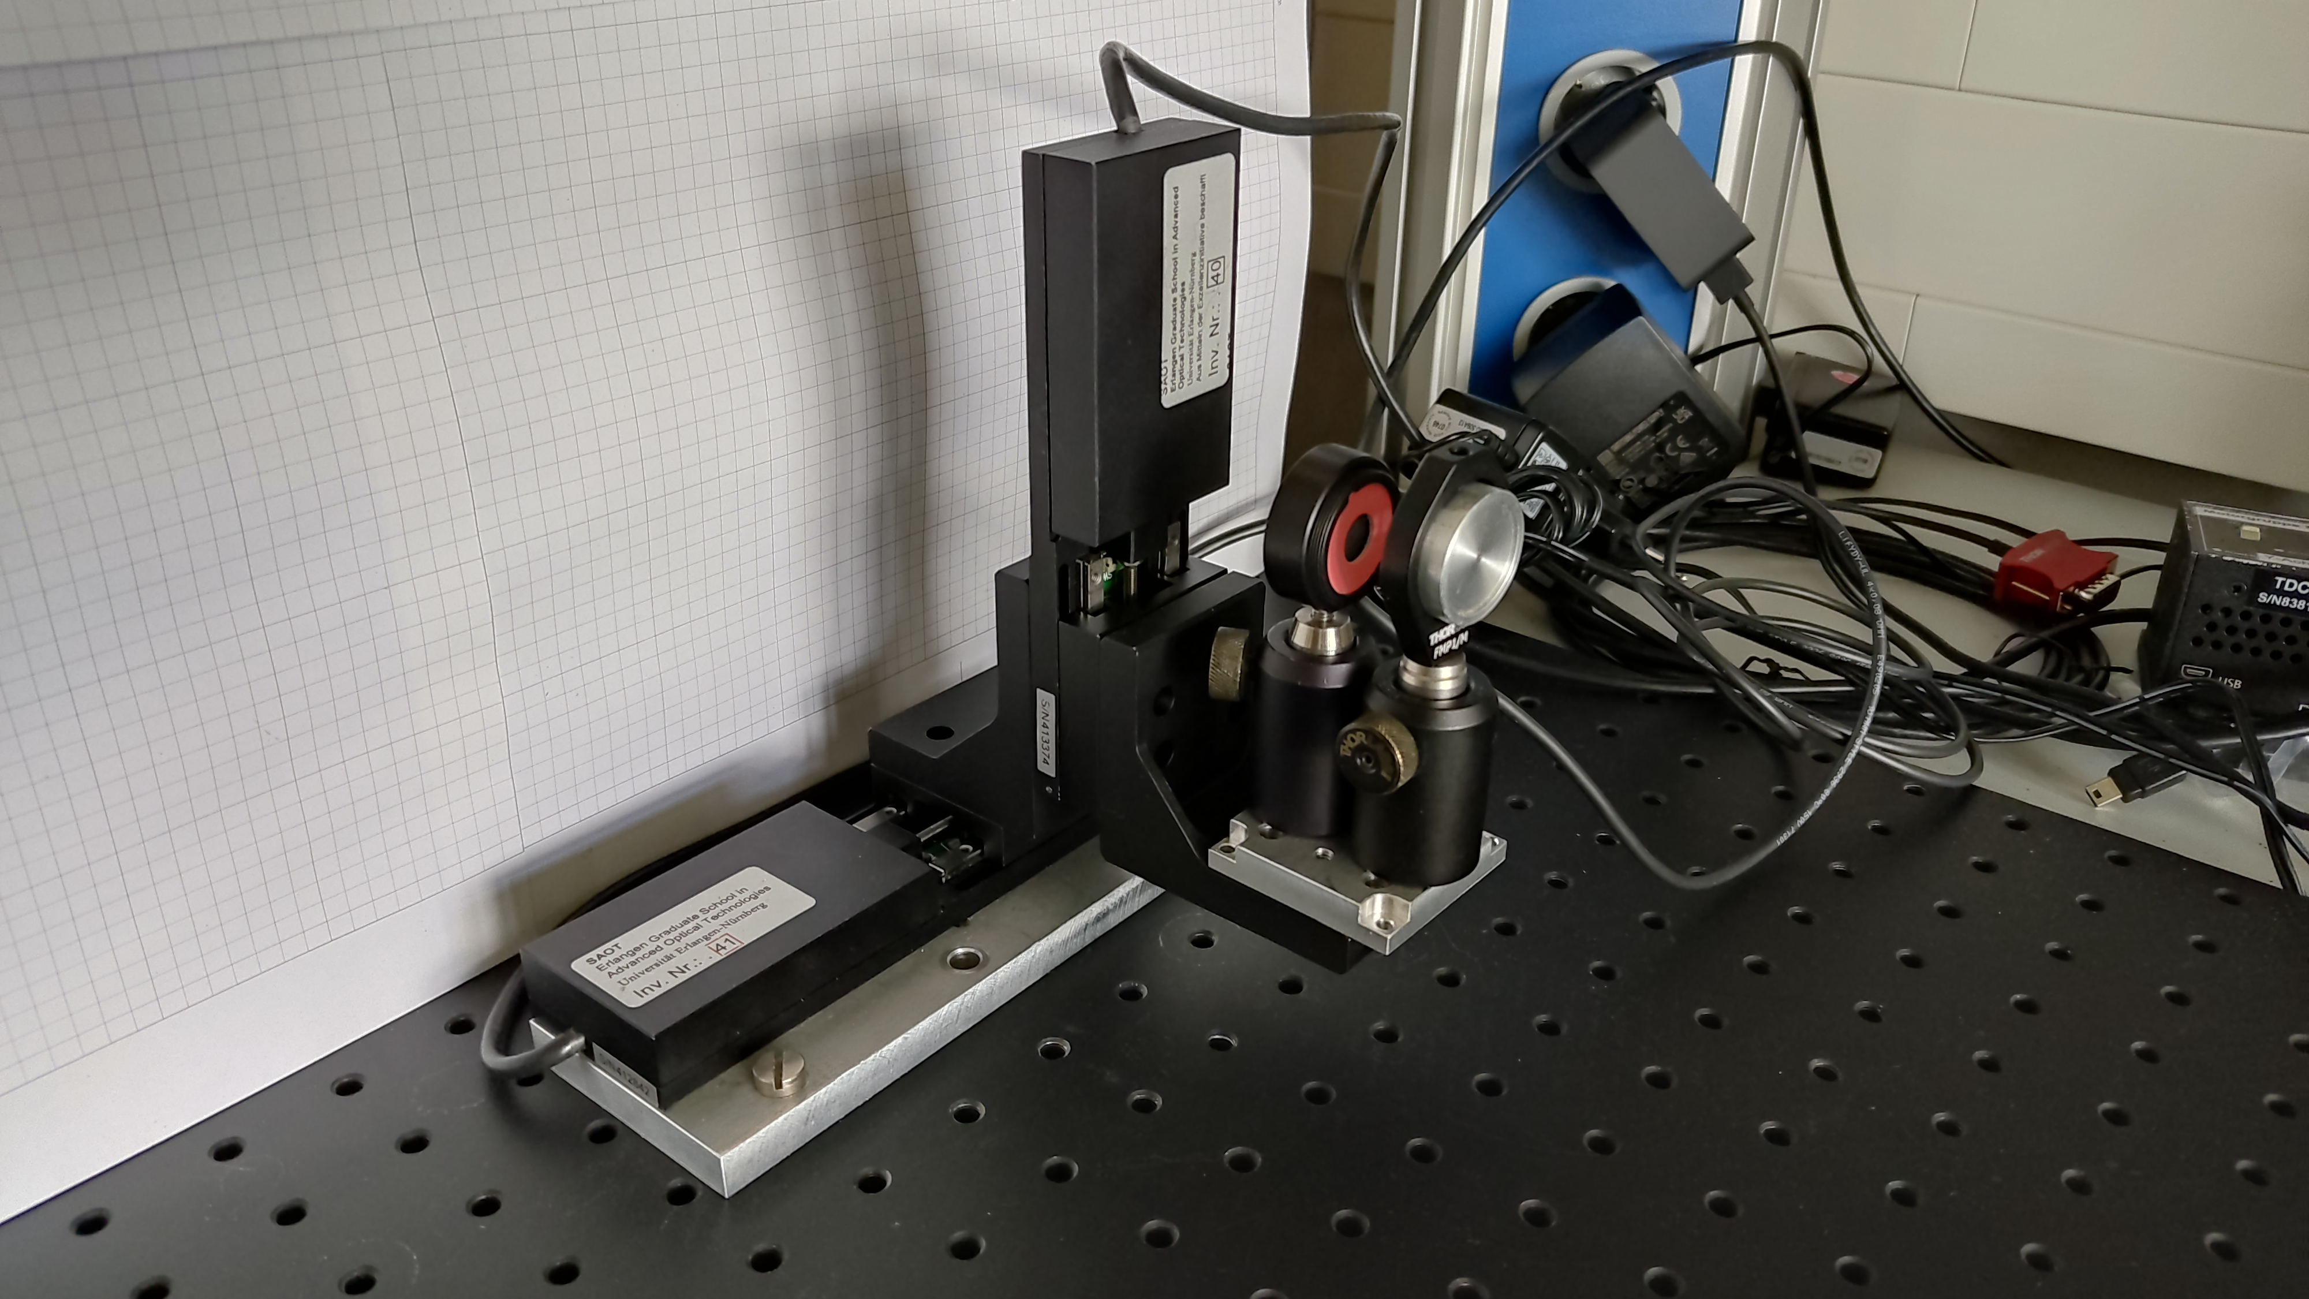
Position Test Setup

Slide 3
Laser Position Accuracy Test Results
Distance between mirror and target plane: 425 mm
Mirror Input (mm) | Mirror Input y (mm) | Measured Distance (mm)
-3 | 0 | -2.956
-2.5 | 0 | -2.469
-2 | 0 | -1.967
-1.5 | 0 | -1.455
-1 | 0 | -0.986
-0.5 | 0 | -0.496
0 | 0 | 0.0
0.5 | 0 | 0.481
1 | 0 | 0.967
1.5 | 0 | 1.463
2 | 0 | 1.922
2.5 | 0 | 2.412
3 | 0 | 2.91

Slide 4
Laser Position Accuracy Test Results
Distance between mirror and target plane: 225 mm
Mirror Input (mm) | Mirror Input y (mm) | Relative Distance (mm)
-3 | 0 | -2.992
-2.5 | 0 | -2.488
-2 | 0 | -1.982
-1.5 | 0 | -1.491
-1 | 0 | -0.984
-0.5 | 0 | -0.523
0 | 0 | 0.0
0.5 | 0 | 0.479
1 | 0 | 0.971
1.5 | 0 | 1.503
2 | 0 | 1.994
2.5 | 0 | 2.483
3 | 0 | 2.975

Slide 5
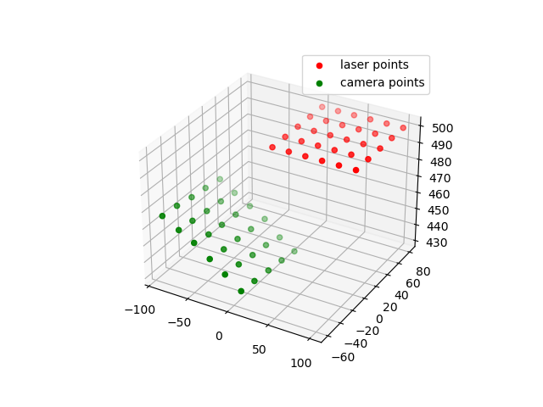
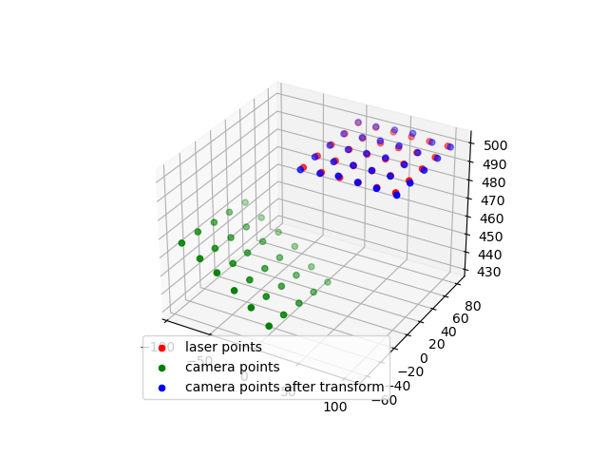
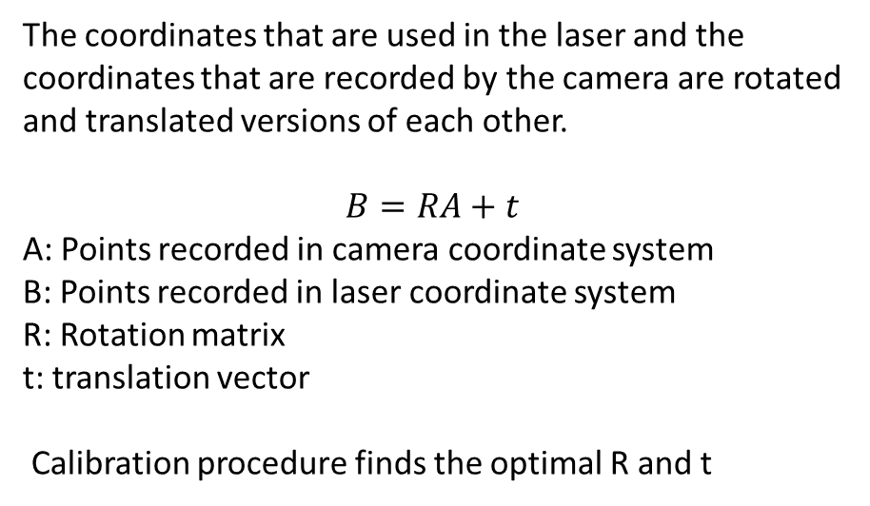
Calibration Procedure
The coordinates that are used in the laser and the coordinates that are recorded by the camera are rotated and translated versions of each other.
$$B=RA+t$$
A: Points recorded in camera coordinate system
B: Points recorded in laser coordinate system
R: Rotation matrix
t: translation vector
Calibration procedure finds the optimal R and t
Recorded points before calibration
Recorded points after calibration

Slide 6

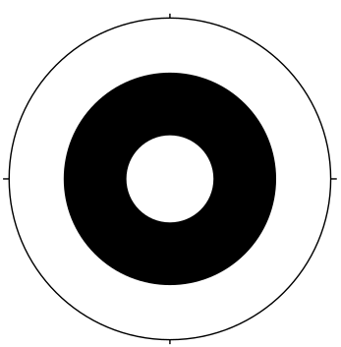
Marker Detection Algorithms
Algorithm | Runtime (ms)
ARuCO | 4-30
WHYCon | 2-3
Hough Circle Detector | 8-10
WHYCon algorithm is used in the system
ARuCO marker
WHYCon marker

Slide 7
Camera Latency
Windows Latency (ms) from Color Camera¹
Resolution | MJPG | NV12 | YUY2 | BGRA32
4096 x 3072 | 111 | - | - | 168
3840 x 2160 | 72 | - | - | 161
2048 x 1536 | 59 | - | - | 72
2560 x 1440 | 67 | - | - | 85
1920 x 1080 | 63 | - | - | 75
1280 x 720 | 62 | 66 | 59 | 68
Latency (ms) from Depth Camera¹
Depth Mode | Resolution | Linux | Windows
NFOV Binned | 320 x 288 | 42 | 36
NFOV Unbinned | 640 x 576 | 42 | 35
WFOV Binned | 512 x 512 | 33 | 27
WFOV Unbinned | 1024 x 1024 | 73 | 62
Passive IR | 1024 x 1024 | 15 | 13
Measured Total System Latency: 85 ms
1: https://github.com/microsoft/Azure-Kinect-Sensor-SDK/issues/816

Slide 8
Tracking Performance
Parts of Code | Elapsed Time (ms)
Capturing Color Image | 3
Marker Detection | 2
Transforming Depth Image to Color Camera´s Coordinate System | 15
3D to mirror coordinate conversion | 1
Mirror Adjustment | 2
Total time | 23
Typical speed range of target (mm/s): 0 - 500
Typical tracking lag due to latency (mm): 0 - 42.5

Slide 9
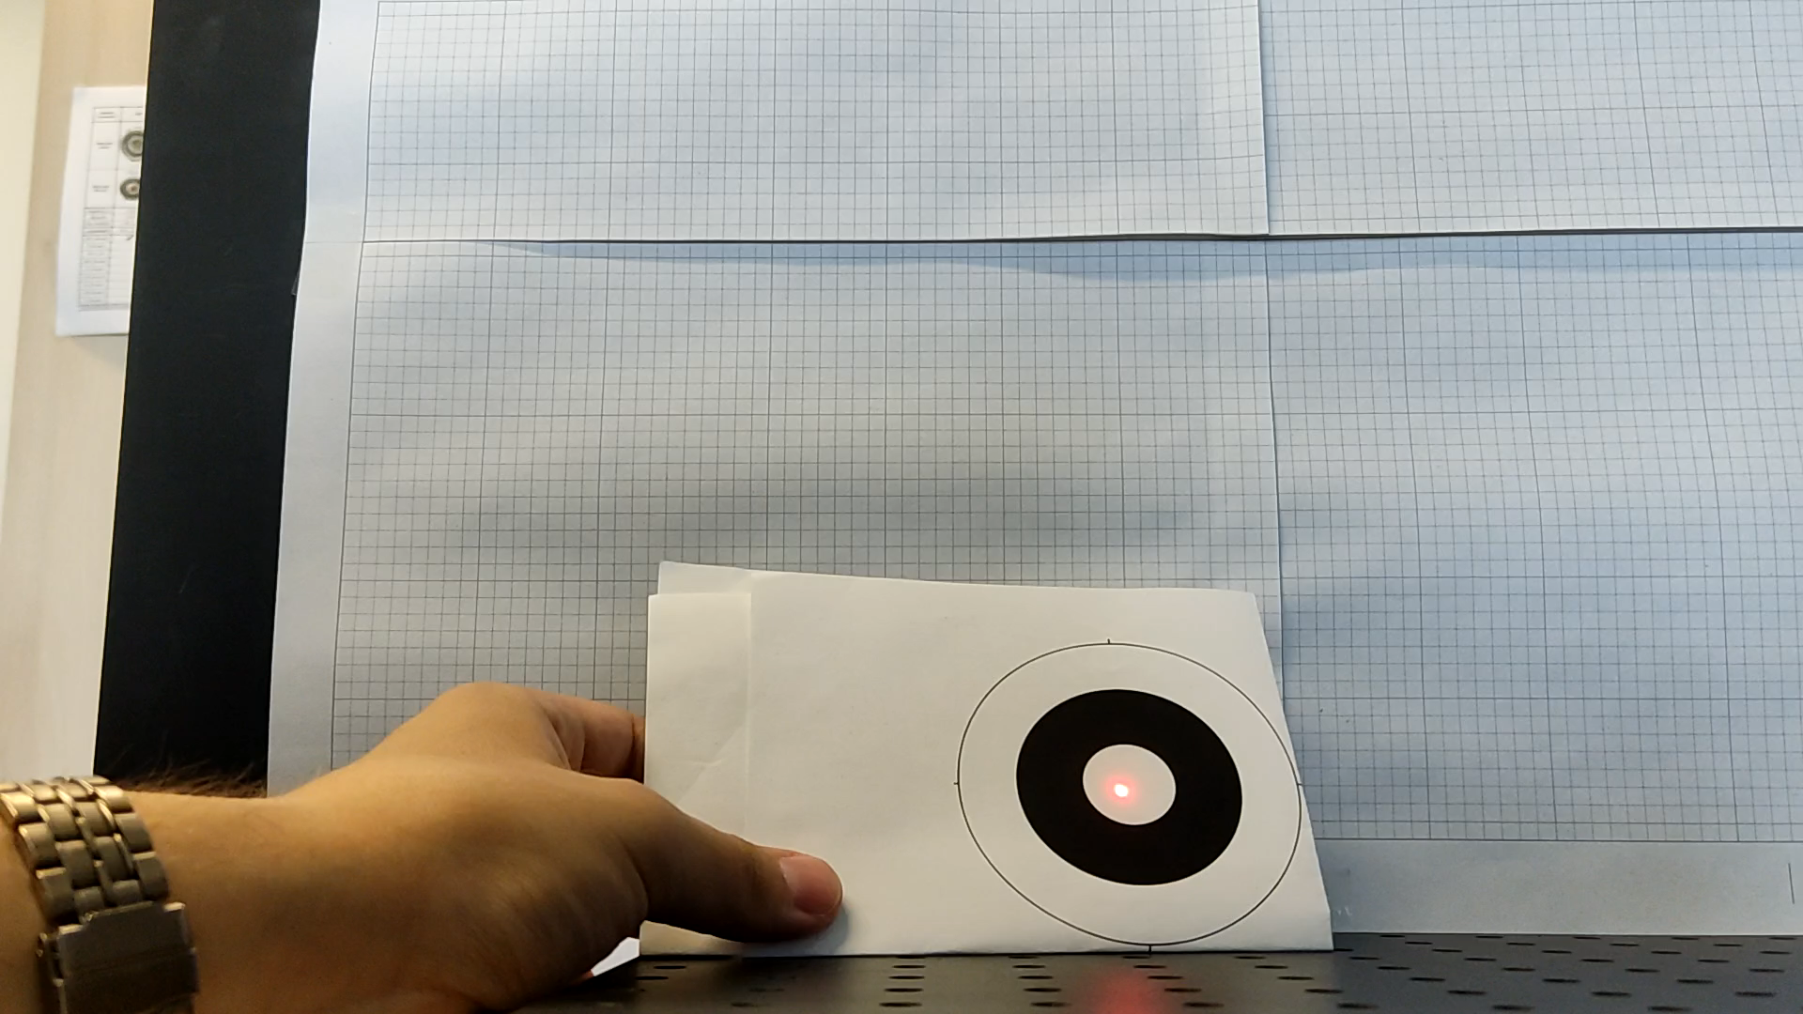
Target Tracking Demo

